Slide 1
Text Classification
Maryam Zubair
Student Id : 19709

Slide 2
Table of Content
Introduction
Text classification and Naive Bayes
Applications
Problem
Training
Testing
Conclusion

Slide 3
Introduction
Text classification is a natural language processing (NLP) technique which we use to assign predefined categories or labels to a given text document. It is a type of supervised learning algorithm where the machine learning model is trained on a labeled dataset. We use text classification learning to classify new unlabeled documents into one or more categories.

Slide 4
Text Classification and Naive Bayes
Naive Bayes is a probabilistic algorithm which is commonly used for text classification tasks. The Naive Bayes algorithm is based on Bayes' theorem. It calculates the probability of a particular event occurring given some prior knowledge or evidence.
So in text classification, this prior knowledge is the frequency of words in the training dataset. Naive Bayes makes the assumption that the presence of a particular word in a document is independent of the presence of other words.

Slide 5
Applications
Assigning subject categories, topics or genres
Spam detection
Authorship identification
Age/gender identification
The identification of the language used in a document
Sentiment analysis (positive or negative movie review)

Slide 6
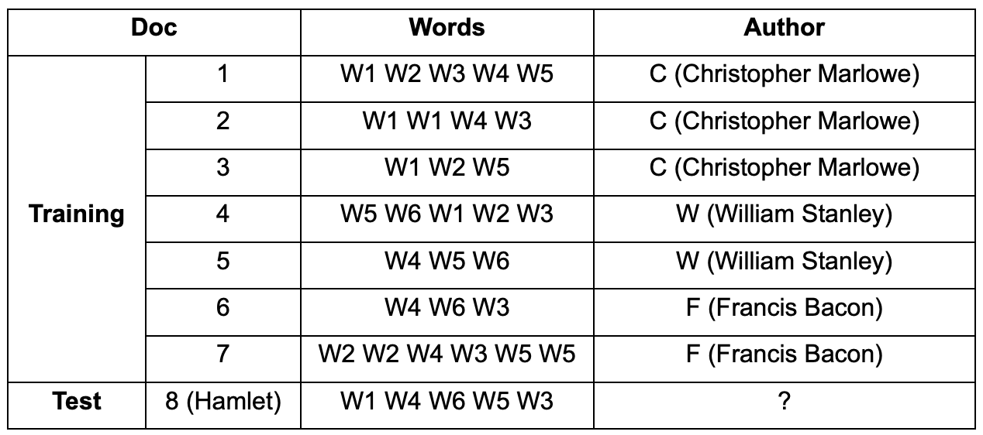
Problem:-
We have to test the Text Classifier to see who is the real author of Hamlet?
P(w|x) = (count(w, x) + 1) / (count(x)+|V|)
count(w, x): how many times the word w appears on the x class documents.
count(x): how many words on the x class documents.
|V|: number of vocabulary = number of different words

Slide 7
Training
Firstly we need to train the model for text classification in order to teach the model how to recognize patterns in text data and then will make predictions on new unseen text data.
Priors:
P(x) = Number of class X / total number of classes
P(x) = NX / N
P(C) = 3/7
P(W) = 2/7
P(F) = 2/7
Conditional Probability:
P(w|c) = (count(w, c) + 1) / (count(c)+|V|)
P(W1|C) = 4+1/12+6 = 5/18
P(W3|C) = 2+1/12+6 = 1/6
P(W4|C) = 2+1/12+6 = 1/6
P(W5|C) = 2+1/12+6 = 1/6
P(W6|C) = 0+1/12+6 = 1/18

Slide 8
Training
Conditional Probability:
P(w|w) = (count(w, w) + 1) / (count(w)+|V|)
P(W1|W) = 1+1/8+6 = 1/7
P(W3|W) = 1+1/8+6 = 1/7
P(W4|W) = 1+1/8+6 = 1/7
P(W5|W) = 2+1/8+6 = 3/14
P(W6|W) = 2+1/8+6 = 3/14
Conditional Probability:
P(w|F) = (count(w, F) + 1) / (count(F)+|V|)
P(W1|F) = 0+1/9+6 = 1/15
P(W3|F) = 2+1/9+6 = 3/15
P(W4|F) = 2+1/9+6 = 3/15
P(W5|F) = 2+1/9+6 = 3/15
P(W6|F) = 1+1/9+6 = 2/15

Slide 9
Testing
Now testing a text classification model by applying compare model.
P(C|d8):
Applying compare model :
P(c|d8) ∝ P(C) * (P(W1|C)) * P(W4|C) * P(W6|C)* P(W5|C)* P(W3|C)
= (3/7) * ( (5/18) * (1/6) * (1/18) * (1/6) * (1/6) )
= 0.0000306
P(W|d8):
P(W|d8) ∝ P(W) * (P(W1|W)) * P(W4|W) * P(W6|W)* P(W5|W)* P(W3|W)
= (2/7) * ( (2/14) * (2/14) * (3/14) * (3/14) * (2/14) )
= 0.0000382
P(F|d8):
P(F|d8) ∝ P(F) * (P(W1|F)) * P(W4|F) * P(W6|F)* P(W5|F)* P(W3|F)
= (2/7) * ( (1/15) * (3/15) * (2/15) * (3/15) * (3/15) )
= 0.0000203

Slide 10
Conclusion
Compare the probability result those three authors:
P(c|D8) =0.0000306
P(w|D8) = 0.0000382
P(F|D8) = 0.0000203
Document 8 should belong to class ‘W’ as it has the highest probability among all.

